Slide 2
Cleveland
Notes:
Cleveland
Give me something to

Slide 3
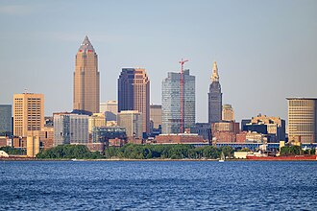
Notes:
Believe in
Something in which to

Slide 4
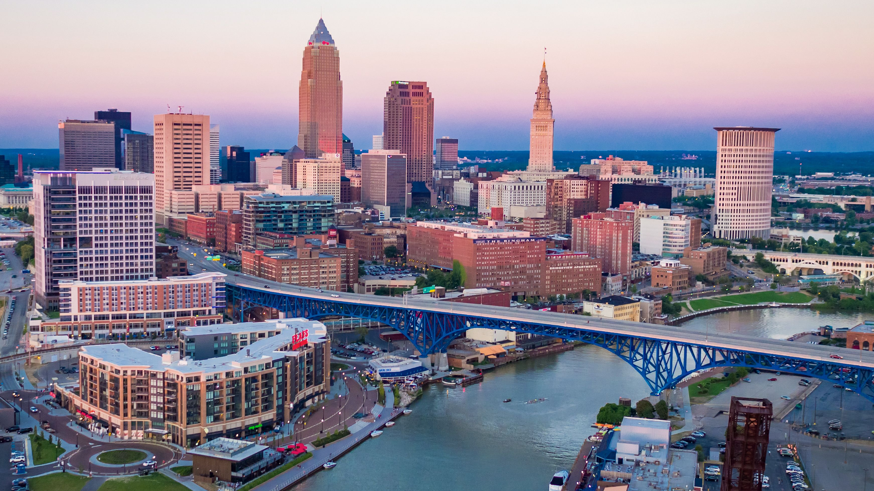
Notes:
Believe, something hiding up your

Slide 5

Notes:
Sleeve, save us from fiscal

Slide 6

Notes:
devastation

Slide 7
Cleveland
Notes:
Cleveland
Need a superstar next

Slide 8

Notes:
Season
You can give us what we

Slide 9
Notes:
Need, we want so badly to

Slide 10

Notes:
Succeed, and Cleveland, you can be the

Slide 11
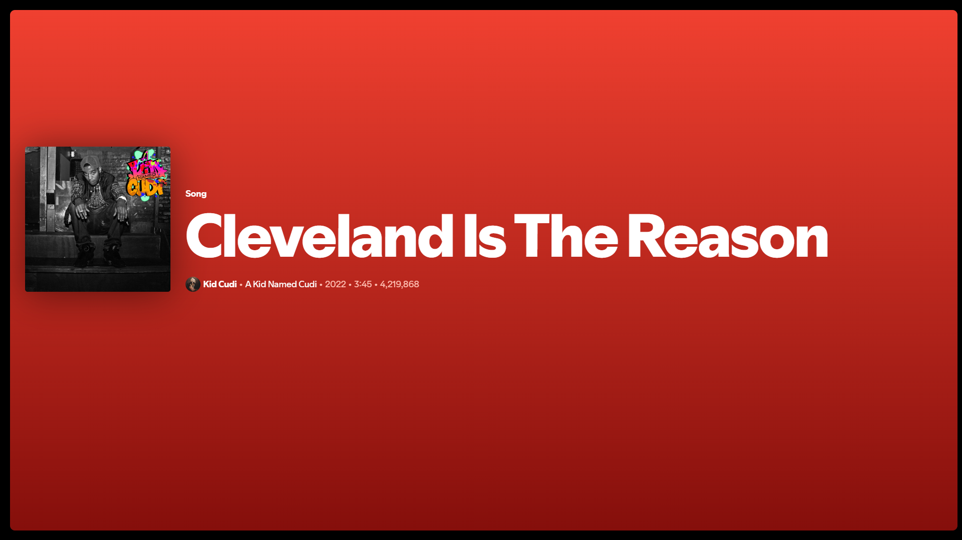
Notes:
Reason… we’ve gotta

Slide 12
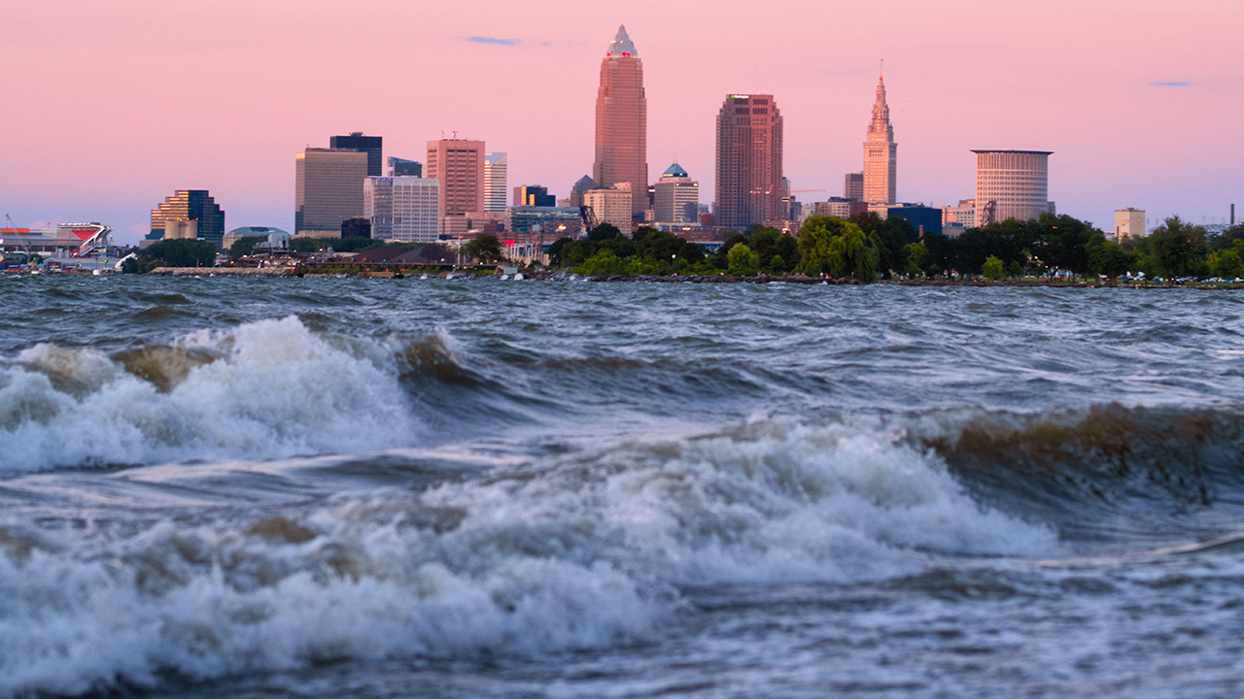
Notes:
Find a diamond in the rough any

Slide 13
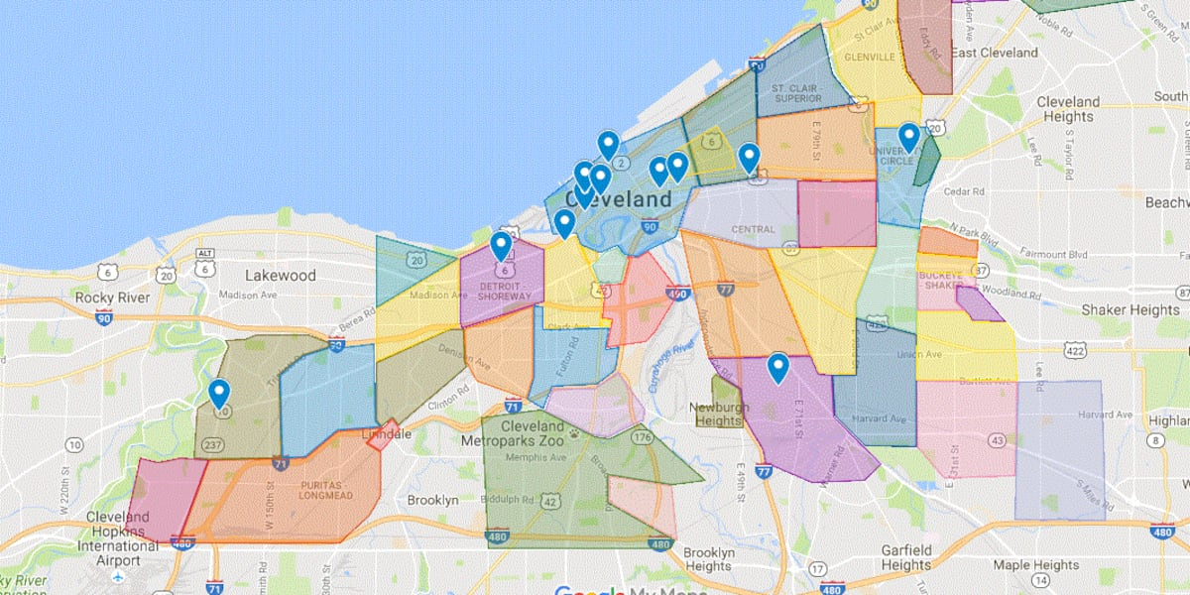
Notes:
neighborhood will do

Slide 14
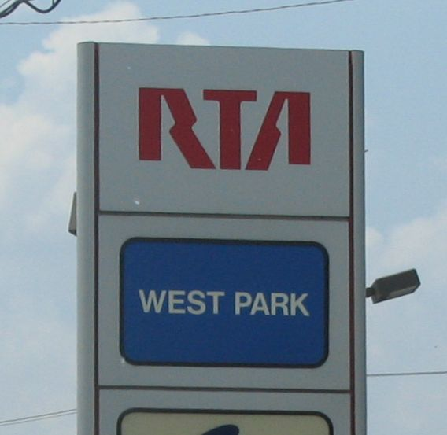
Notes:
West Park

Slide 15
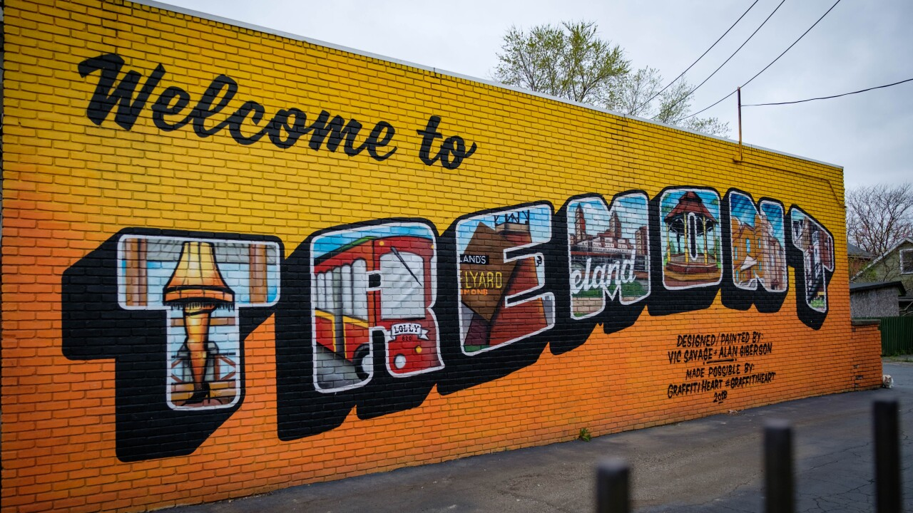
Notes:
Tremont or

Slide 16

Notes:
Hough, they tell me that in Cleveland

Slide 17
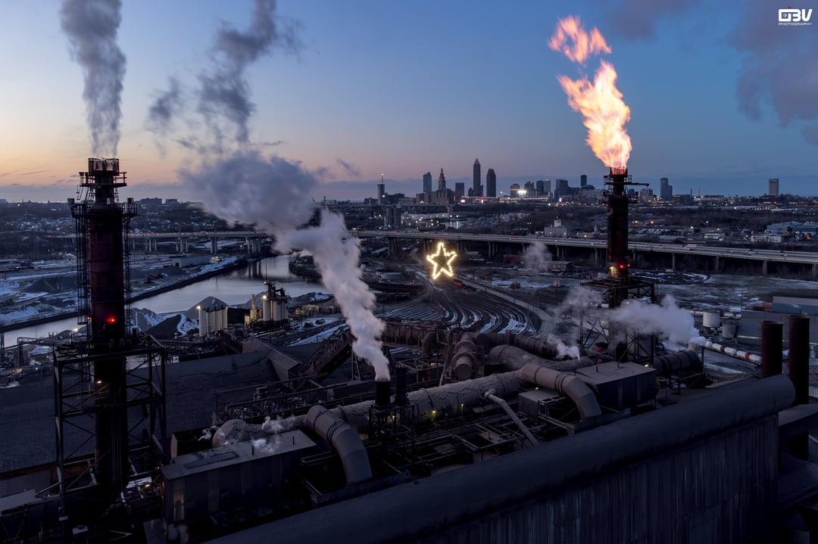
Notes:
You, have got to be

Slide 18

Notes:
Tough, so I’m hoping that there’s someone

Slide 19
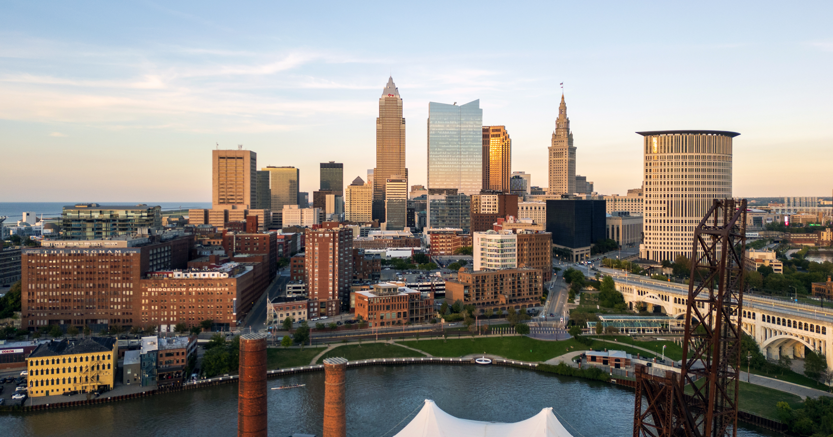
Notes:
There who’s got the right stuff. In

Slide 20
Cleveland
Notes:
Cleveland
Protect our service from

Slide 21

Notes:
Deletion… Quibi got it

Slide 22

Notes:
Pretty quick, and we know seeso couldn’t

Slide 23

Notes:
Stick, but maybe we can keep on

Slide 24
Notes:
Streamin’
If we go to

Slide 25
Cleveland
Notes:
Cleveland
Even though we might be

Slide 26
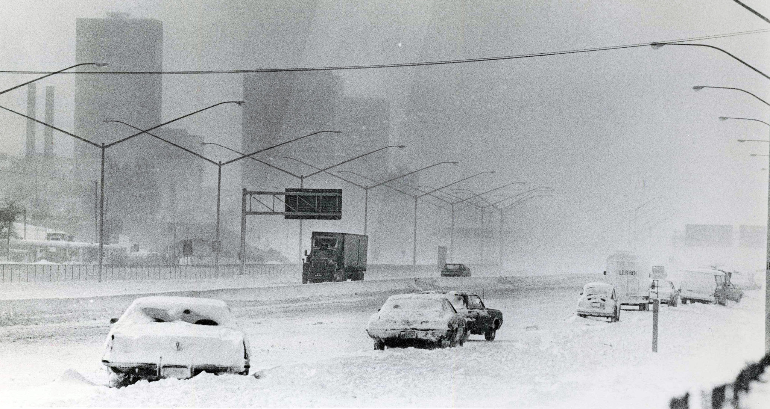
Notes:
Freezin… amidst the potholes and the

Slide 27
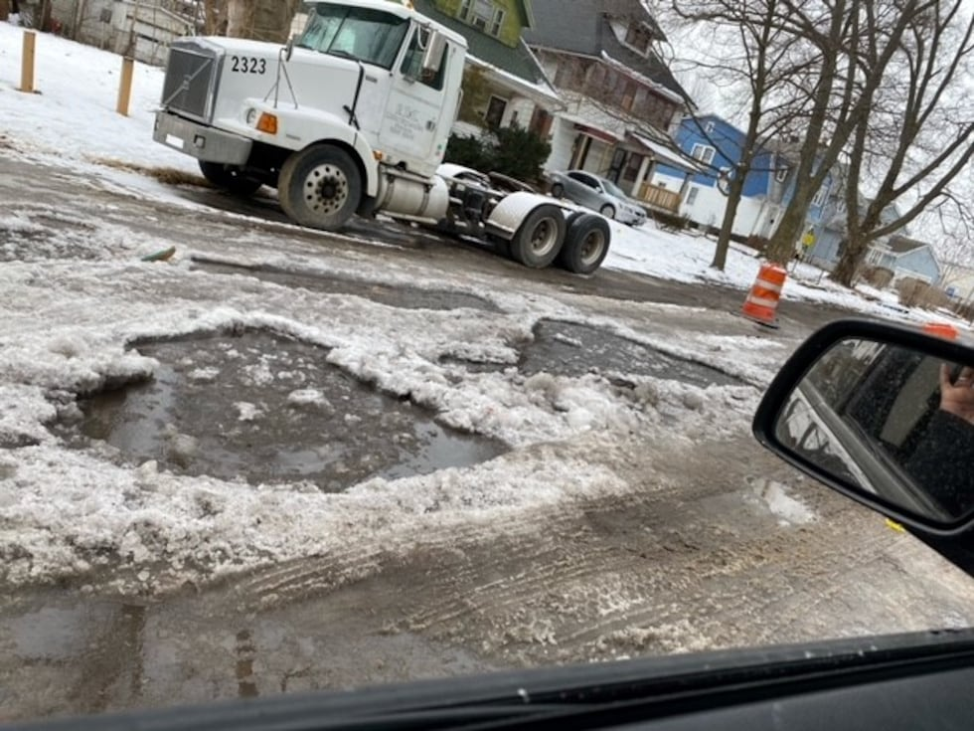
Notes:
Ice, we’ll find a great lakes

Slide 28

Notes:
Paradise from which we’ll pull our next sensation

Slide 29
Notes:
Sensation… we’ll find someone

Slide 30

Notes:
Hot, like a

Slide 31
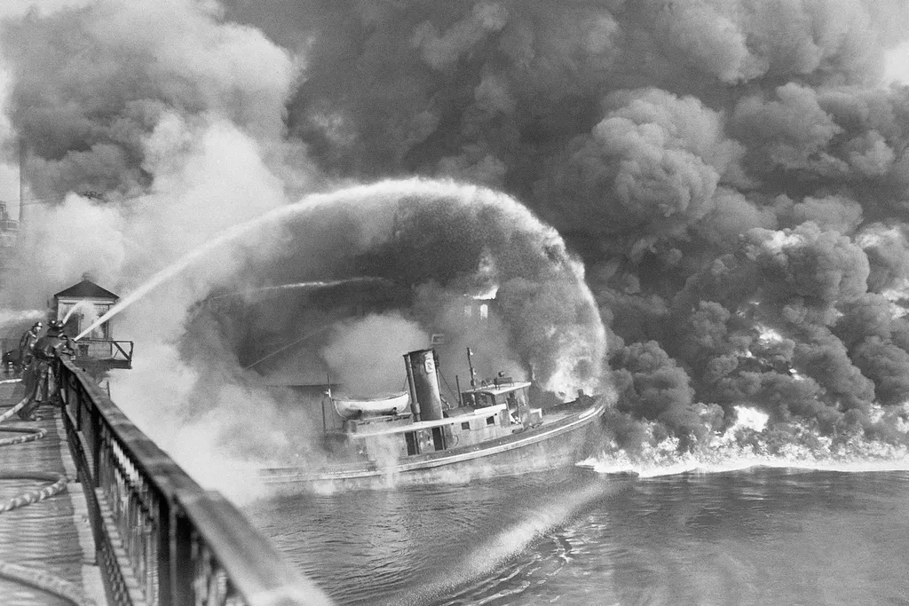
Notes:
River on fire, someone to make the ladies

Slide 32

Notes:
Laugh and all the boys perspire, someone with pure midwestern

Slide 33
Notes:
Charm, and also cutting satire, someone to take our lowly

Slide 34
Notes:
Ratings and make them higher

Slide 35
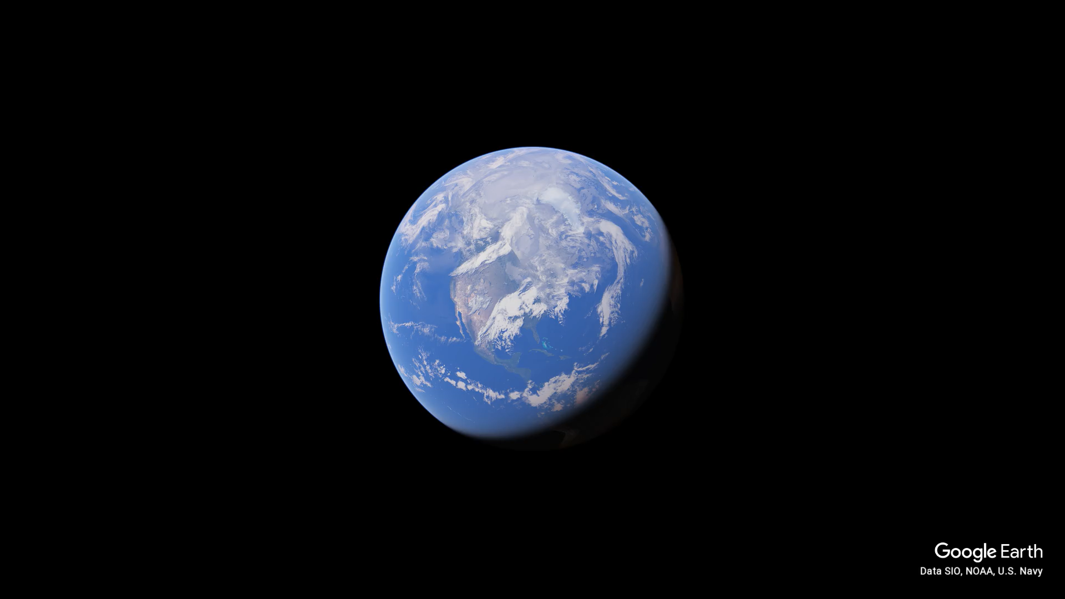
Notes:
Not sure if I know
Exactly why oh
But I know I oh
I just have to fly oh
Straight to Ohio

Slide 36
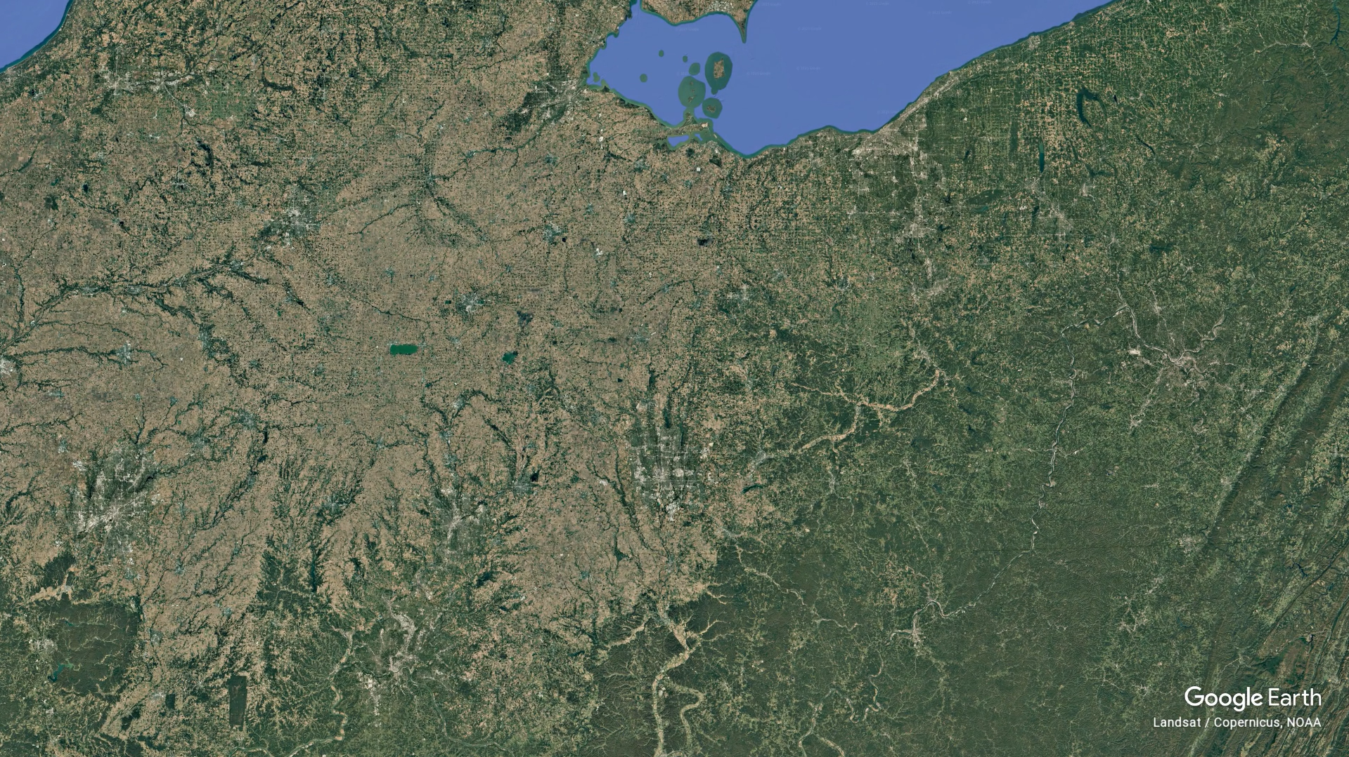
Notes:
And more specifically
Click

Slide 37
Cleveland
Notes:
Cleveland
Give me someone to believe in
Someone in whom to believe
Someone hiding up your sleeve
Save us from fiscal devastation

Slide 38

Notes:
Cleveland, we need a superstar next

Slide 39
Notes:
Season
You can give us what we

Slide 40
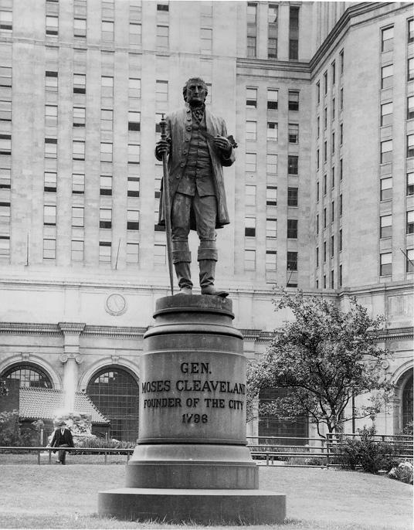
Notes:
Need, we want so badly to

Slide 41
Notes:
Succeed, and Cleveland, you can be the

Slide 42
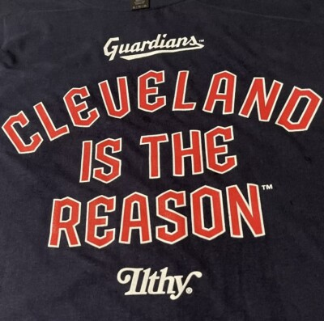
Notes:
Reason… It’s

Slide 43
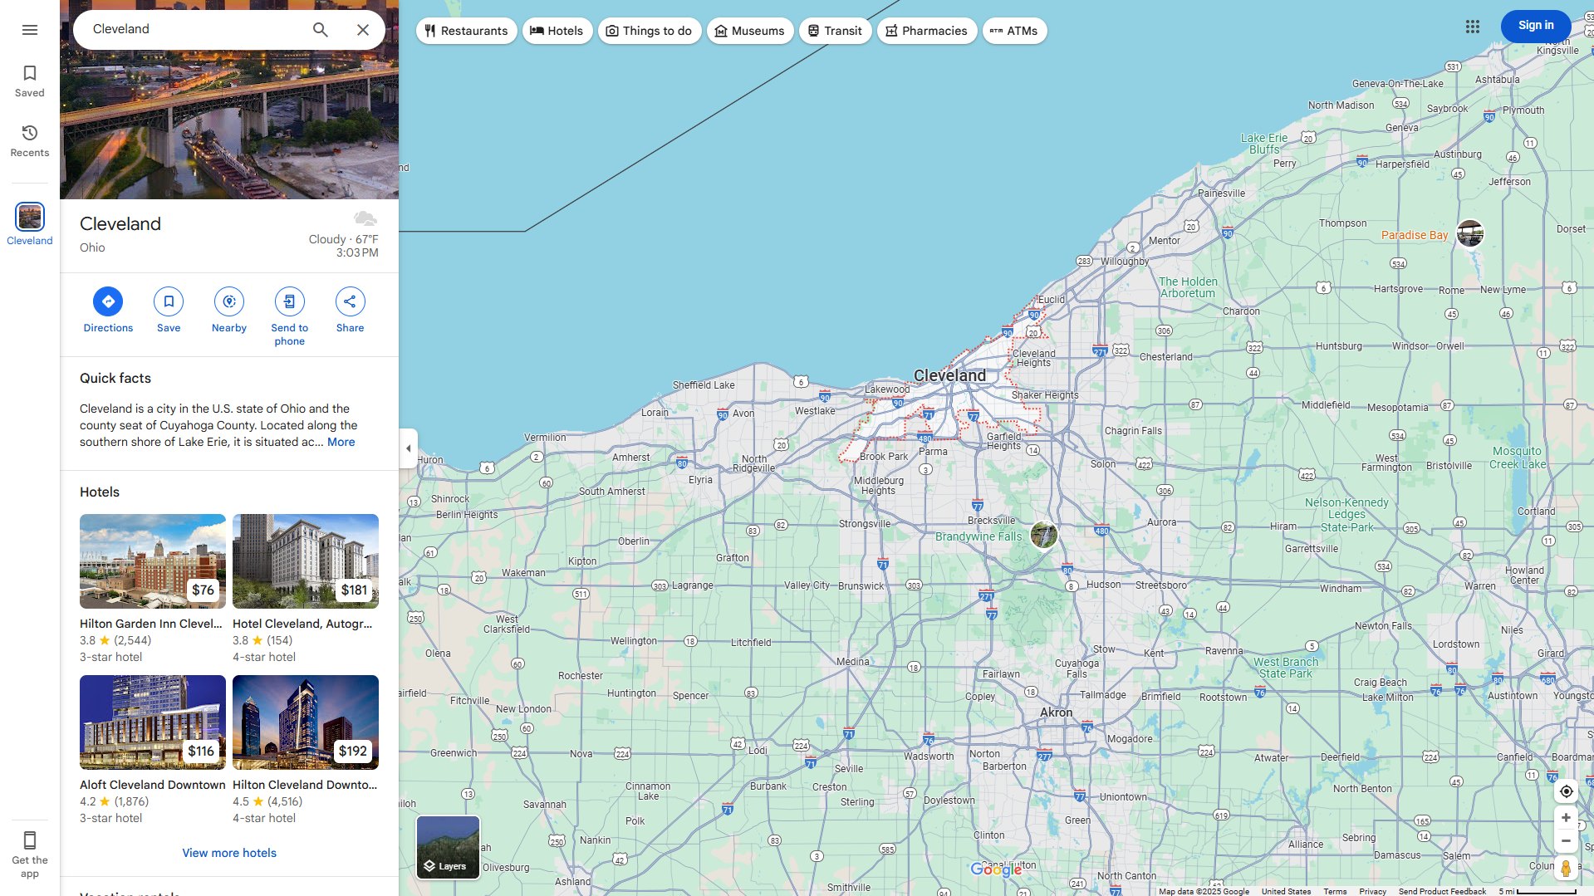
Cleveland
Notes:
Cleveland and the greater cleveland

Slide 44
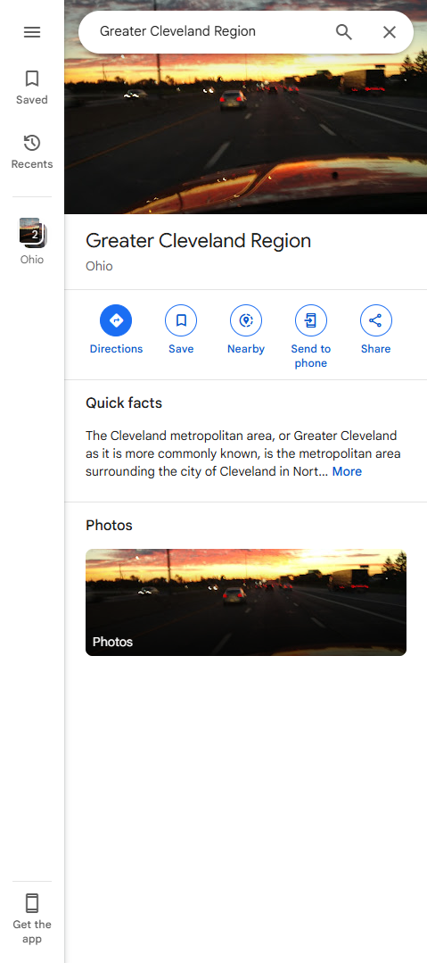
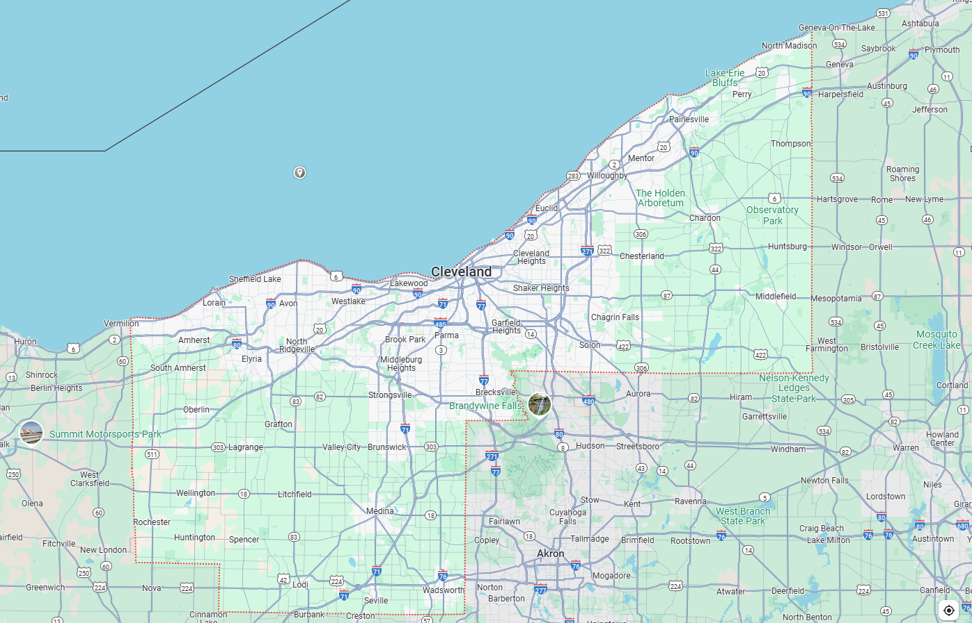
Cleveland
Notes:
Region gave us big

Slide 45
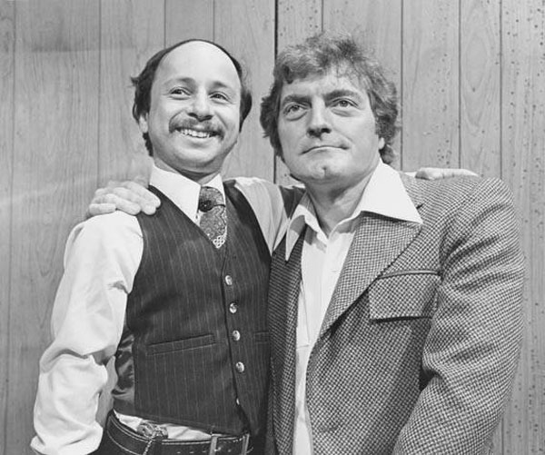
Notes:
Chuck and lil john

Slide 46
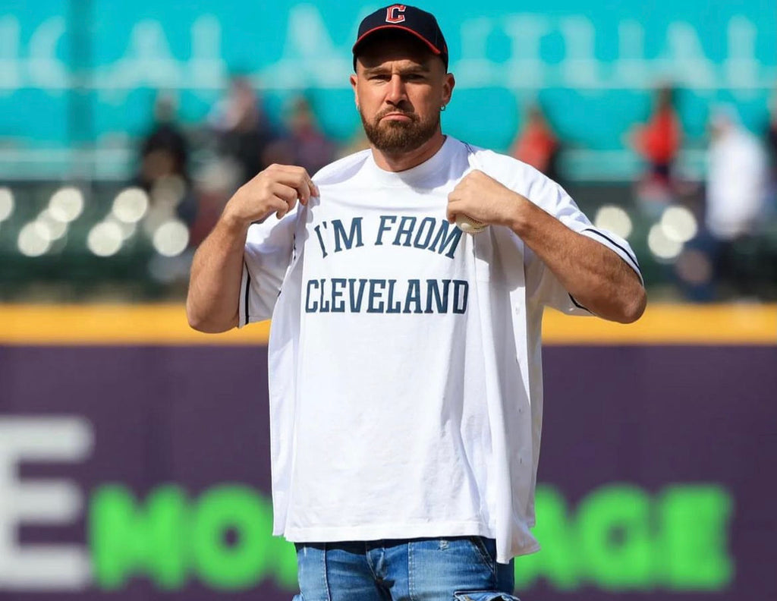
Notes:
Travis kelce and

Slide 47
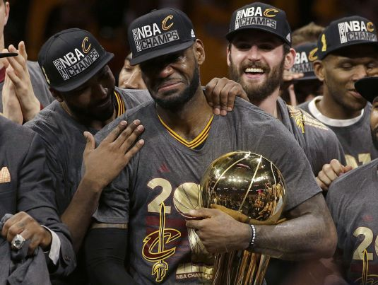
Notes:
Lebron we just need one more grea

Slide 48
Drew carey silhouette
Notes:
Comedian. I’m begging you

Slide 49
Cleveland
Notes:
Cleveland
Best location in the

Slide 50

Notes:
Nation… you’re my last and only shot

Slide 52
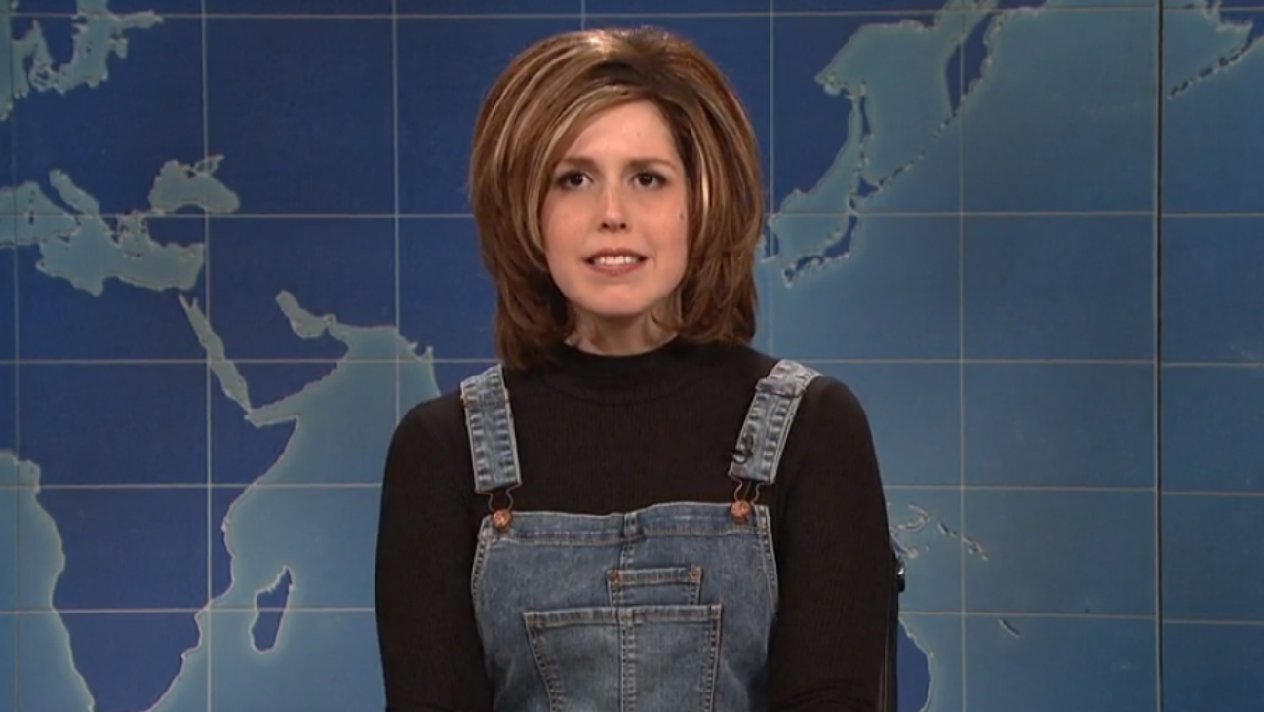


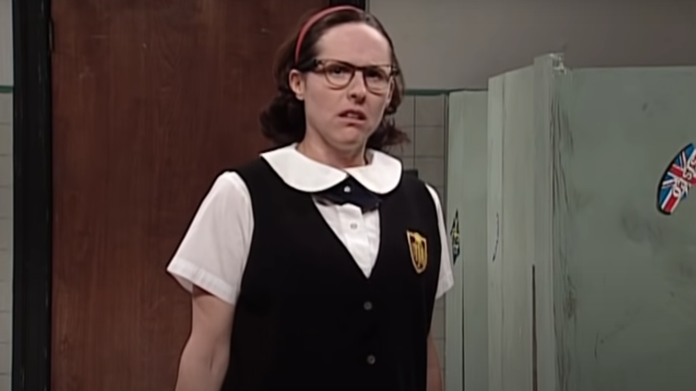
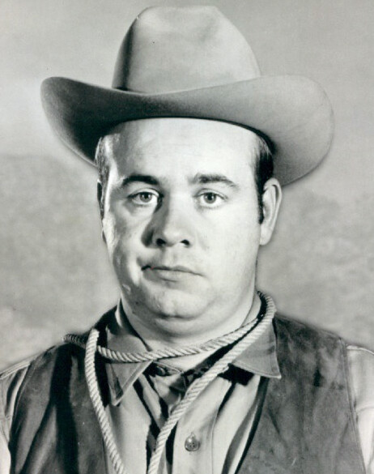

Slide 53
